Slide 1
Predicting life expectancy
Data101 Final Project
Jonathan Arredondo

Slide 2
GOAL
Determine what factors play a role in life expectancy and predict it based on those factors

Slide 3
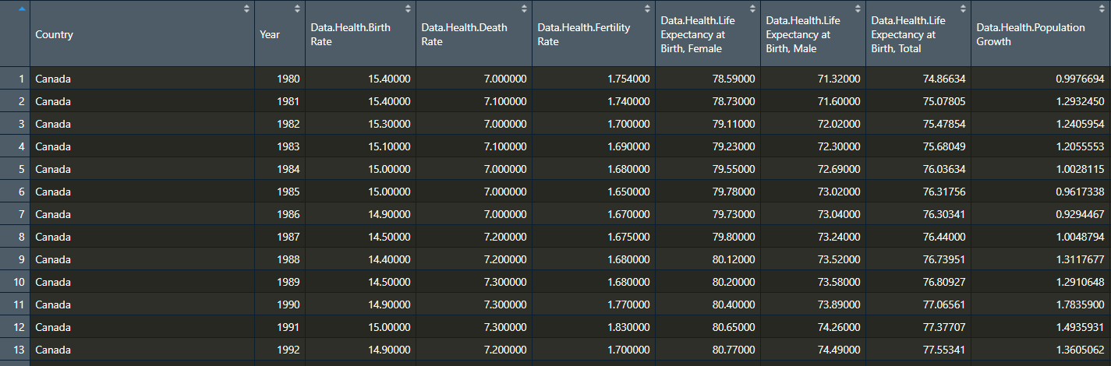
Dataset
Global development indicators
World Bank, 1980-2013
Data about urban development, agriculture and rural development, health, and infrastructure.

Slide 4
1.
PLOTS

Slide 5
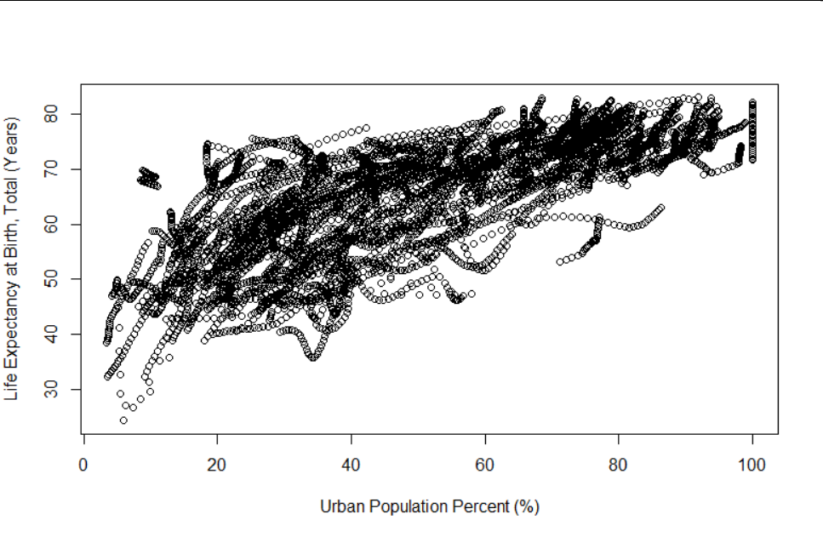

Slide 6
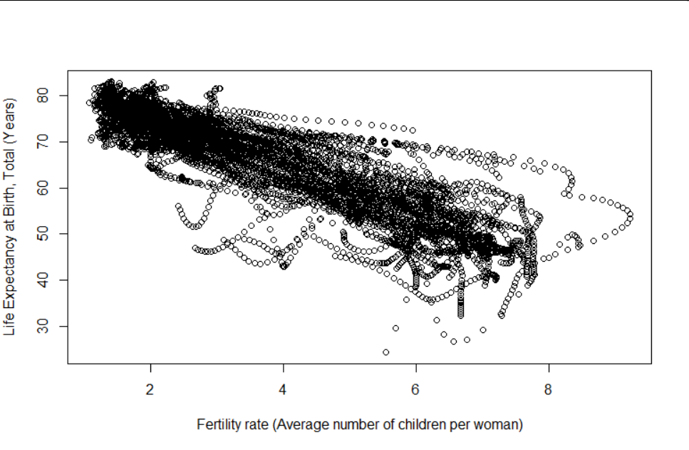

Slide 7
2.
PREDICTION MODELS

Slide 8
What were my prediction models?
Linear regression models and decision trees for each individual predictor.
Linear regression models and decision trees combining both predictors.
Dataset was split 80% training - 20% testing to do cross-validation

Slide 9
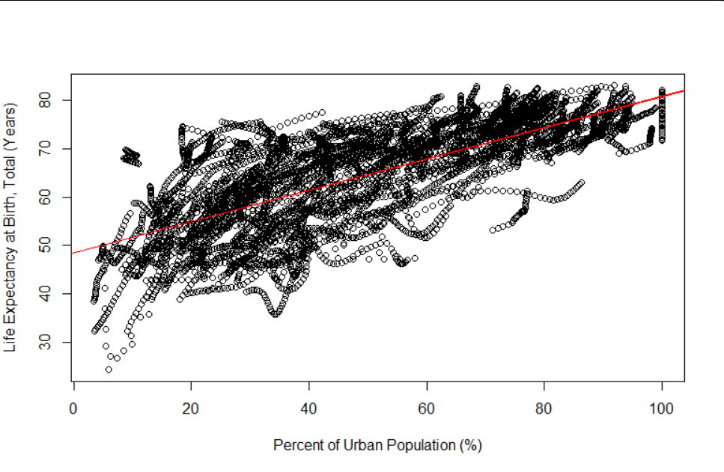
lm(lifeExpectancy~UrbanPopulation%)
RMSE:
7.03

Slide 10
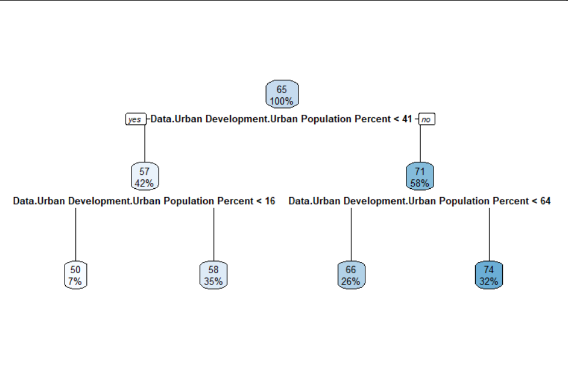
rpart(lifeExpectancy~UrbanPopulation%)
RMSE:
7.1
Relative error:
0.45

Slide 11
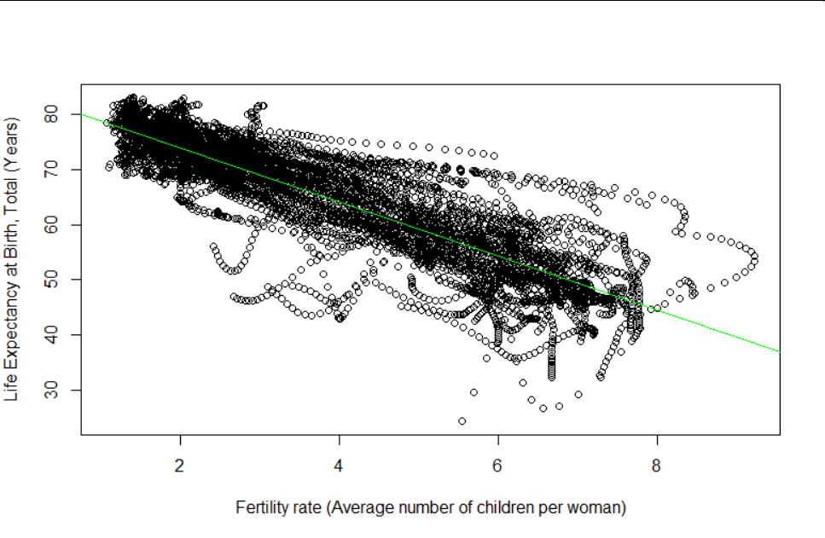
lm(lifeExpectancy~FertilityRate)
RMSE:
5.2

Slide 12
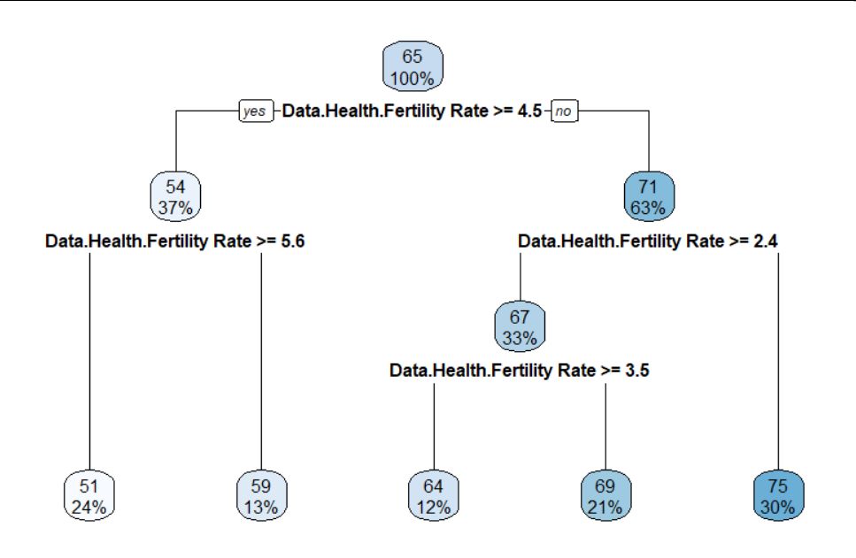
rpart(lifeExpectancy~FertilityRate)
RMSE:
5.35
Relative error:
0.26

Slide 13
Combining both predictors...

Slide 14
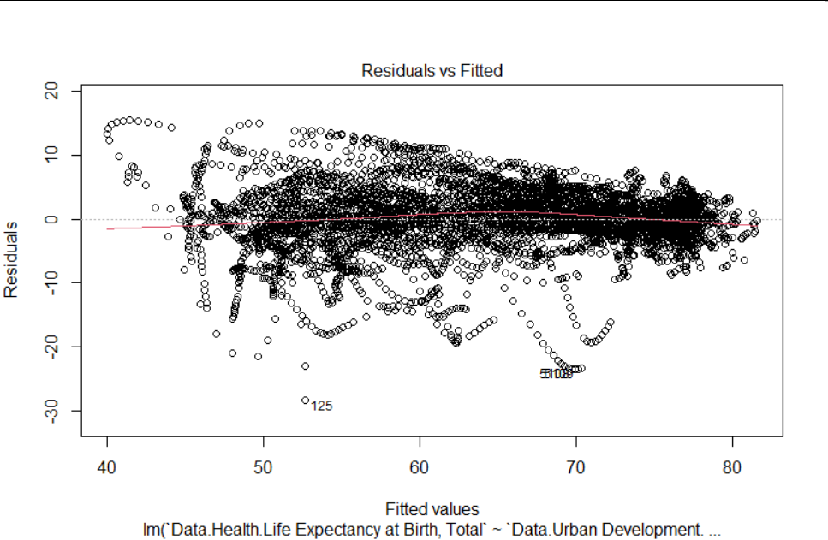
lm()
RMSE:
4.5

Slide 15
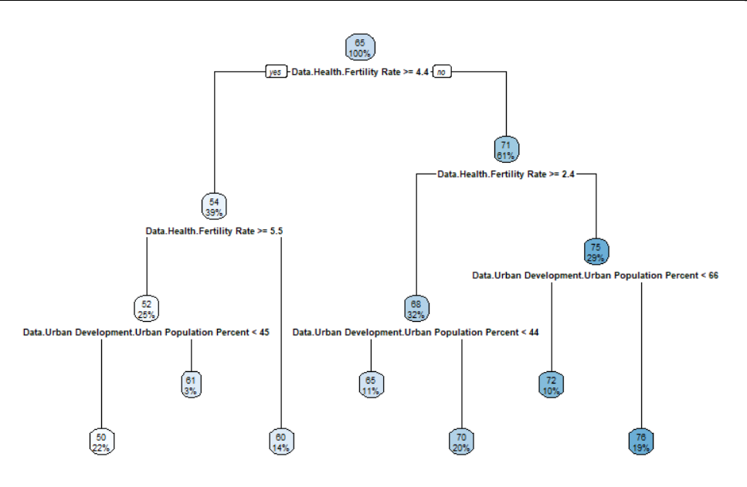
rpart()
RMSE:
4.8
Relative error:
0.22

Slide 16
Why I chose these predictors
Tried multiple attributes in plots
Chose the ones that showed the stronger and clearer correlation
Tested aiming to find the lowest value of RMSE

Slide 17
Limitations?
These correlations may have a deeper common cause
High % Urban population may imply greater health coverage → Direct increase in life expectancy
A substantial decrease in fertility rate would not lead to a substantial increase in life expectancy, but certainly a high fertility rate is an indicator of low life expectancy
Example of correlation not implying causation

Slide 18
New Knowledge and Conclusions
Fertility rate is a slightly better predictor of life expectancy than percentage of urban population
Strong linear correlation between life expectancy and fertility rate + percentage of urban population
In this case, predictors act as reliable indicators that could enable prediction of life expectancy for future years
More accurate prediction models can be build by combining reliable predictors
For this particular case, linear regression models were slightly more accurate than decision trees (rpart)

Slide 19
CREDITS
Special thanks to all the people who made and released these awesome resources for free:
Presentation template by SlidesCarnival
Photographs by Unsplash

